Slide 1
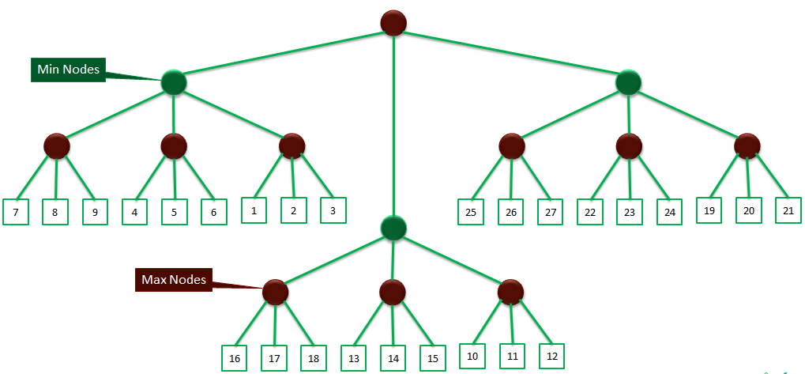
PS_03: Alpha Beta Pruning
Task:
Perform alpha-beta pruning of following tree.
Explain benefit you achieved over exhaustive search.

